Slide 1
ASRU中英混杂语音识别挑战赛线下技术交流会
Towards Language-Universal Mandarin-English Speech Recognition Using DFSMN-CTC-sMBR
张仕良
阿里巴巴-机器智能技术-智能语音交互团队
2019年11月23日

Slide 2
Main
Mandarin Speech Recognition using DFSMN-CTC-sMBR
Zhang S., Lei M., Acoustic Modeling with DFSMN-CTC and Joint CTC-CE Learning. In Interspeech 2018 (pp. 771-775).
Zhang S., Lei M., Liu Y, et al. , Investigation of Modeling Units for Mandarin Speech Recognition Using DFSMN-CTC-sMBR. Proc. of ICASSP 2019: 7085-7089.
Language-Universal Mandarin-English Speech Recognition
Zhang, S., Liu, Y., Lei, M., Ma, B., Xie, L. , Towards Language-Universal Mandarin-English Speech Recognition. Proc. of Interspeech 2019, 2170-2174.

Slide 3
Speech Recognition
ASR
framework
model
criterion
data
GMM-HMM
NN-HMM
End-to-End
FNN
CNN
RNN
LSTM
TDNN
DFSMN
…
Mandarin
English
dialect
multilingual
…
Cross-Entropy
sMBR/MPE
LF-MMI
CTC
Transducer
…

Slide 4
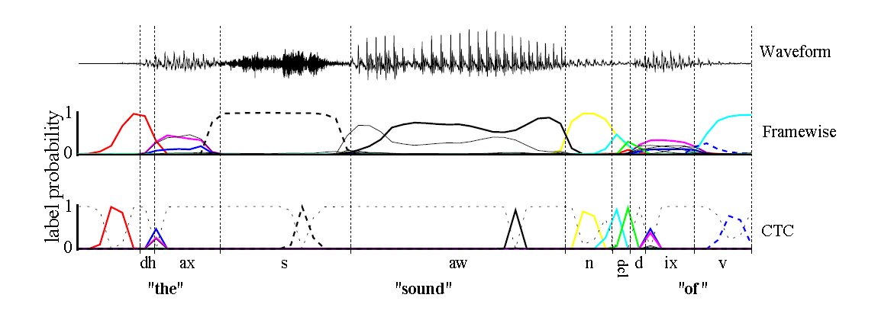
CTC based Acoustic Modeling
Connectionist Temporal Classification
First proposed by Grave @2006 @2013
Successfully applied to LVCSR by Google @2016
LSTM/BLSTM-CTC
CTC Vs. Cross-Entropy
Advantage：better performance, faster decoding speed
Problem： unstable, spike delay et al.
CTC for Mandarin speech recognition
Deep Speech 2【2016】， Zhehuai Chen【2016】， Zhongdi Qu【2017】et al.
Zhang S., Lei M., Acoustic Modeling with DFSMN-CTC and Joint CTC-CE Learning. In Interspeech 2018 (pp. 771-775).
Zhang S., Lei M., Liu Y, et al. , Investigation of Modeling Units for Mandarin Speech Recognition Using DFSMN-CTC-sMBR. Proc. of ICASSP 2019: 7085-7089.

Slide 5
Mandarin Speech Recognition with DFSMN-CTC-sMBR
Acoustic Modeling units for Mandarin
序列(Sequence)
词(word)
玩具 总动员
音节(syllable)
wan2 ju4 zong3 dong4 yuan2
声韵母(IF)
w an2 j u4 z ong3 d ong4 y uan2
字(character)
玩 具 总 动 员
玩具总动员
/s-w-an2 w-an2-j an2-j-u4 …
绑定的声韵母(CD-IF)
数目无穷
上百万
数十万，常用5千
一千多
决策树, 数千
143个
传统语音识别: 绑定的声韵母
基于CTC的识别模型：声韵母、绑定的声韵母、音节、字

Slide 6

Mandarin Speech Recognition with DFSMN-CTC-sMBR
Modeling units：Mixed-syllable-character
Method：frequency character + syllable
Advantage：without OOV problem； lower frame rate
Modeling units： All-Character
Method：frequency character+ character mapping
Advantage： small vocabulary size
modeling units
frequency
Character
frequency Character
All
Characters
OOV
Character
Syllable
Mapped

Slide 7
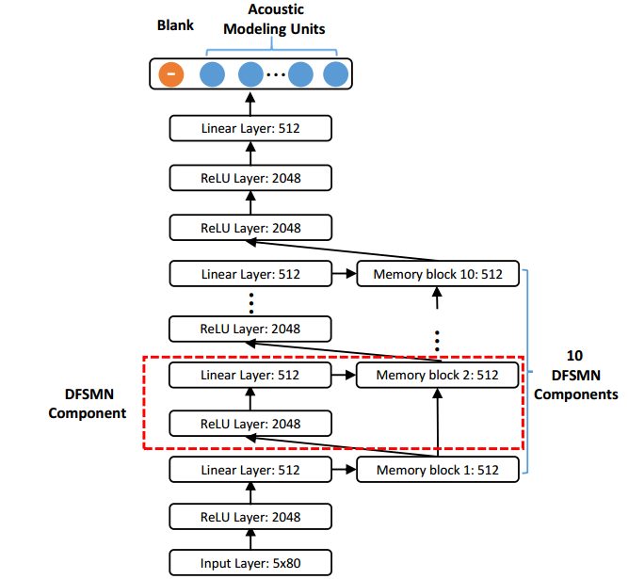
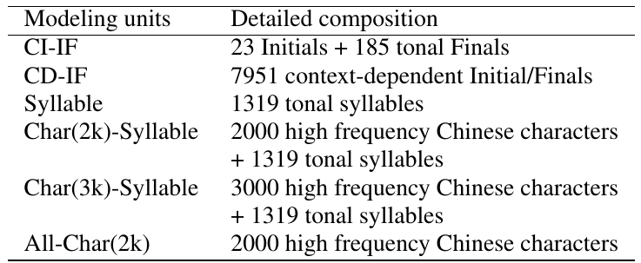
Mandarin Speech Recognition with DFSMN-CTC-sMBR
Why DFSMN ？
Feedforward architecture
Effectively model long-term dependency
Acoustic Modeling units

Slide 8
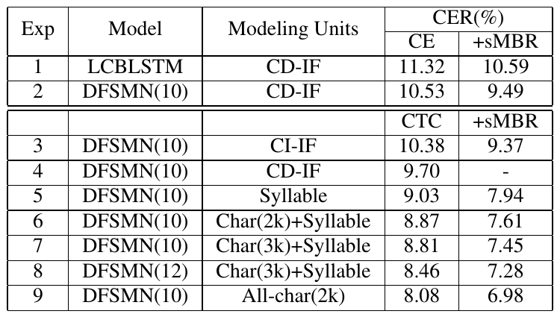
DFSMN-CTC-sMBR for Mandarin Speech Recognition
20000-hours-task
Real Time Factor （RTF）

Slide 9
Language-Universal Mandarin-English ASR
Background: language-specific ASR system
Language-Universal Mandarin-English ASR System
ASR system can recognize Mandarin, English and code-switching speech without any language-specific information.
Challenge
How to model two languages
Code-switching acoustic & text data
Discriminative acoustic score
Our works
CTC-sMBR
Bilingual-AM
Word Space Mapping

Slide 10
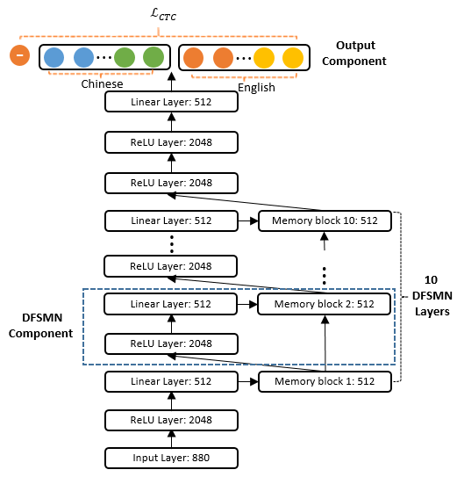
Language-Universal Mandarin-English ASR
Idea 1、Mixed Acoustic Modeling units
Acoustic Model
DFSMN-CTC-sMBR
Training Data
monolingual Mandarin + English
Acoustic Modeling Units
Mandarin：All-character
English: wordpiece

Slide 11
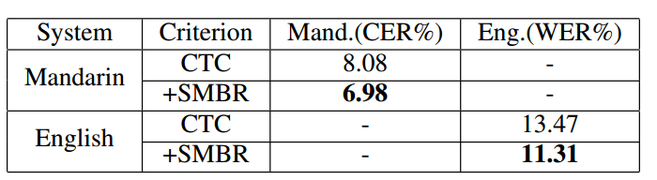
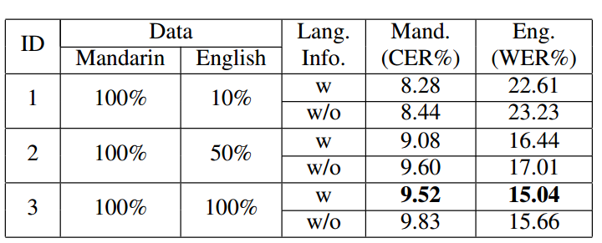
Language-Universal Mandarin-English ASR
Idea 1、Mixed Acoustic Modeling units
Training data
20000-hours-Mandarin + 15000 hours English
Language-specific DFSMN-CTC-sMBR system
Language-universal DFSMN-CTC system with mixed modeling units

Slide 12
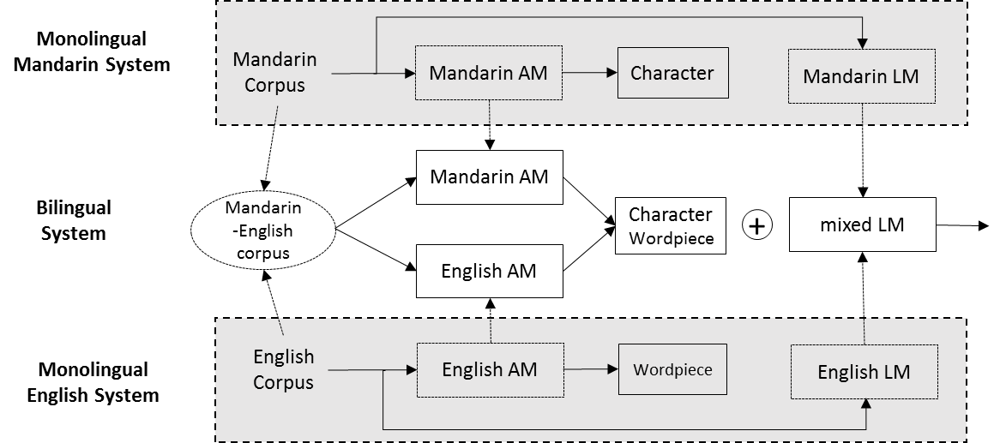
Language-Universal Mandarin-English ASR
Idea2、Monolingual pre-trained Bilingual-AM

Slide 13
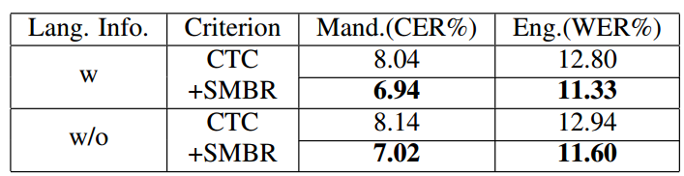
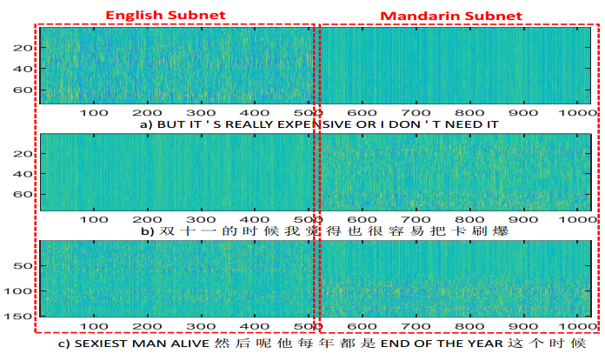
Language-Universal Mandarin-English ASR
Idea2、Monolingual pre-trained Bilingual-AM
Language-specific DFSMN-CTC-sMBR system
Language-universal DFSMN-CTC-sMBR system

Slide 14
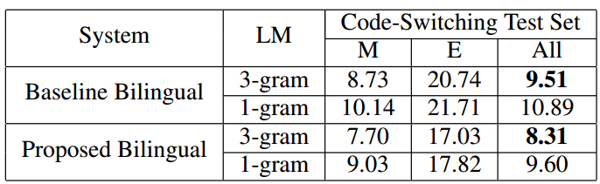
Language-Universal Mandarin-English ASR
Idea2、Monolingual pre-trained Bilingual-AM
Code-switching test set
Code-switching LM score is mostly back-off to 1-gram

Slide 15
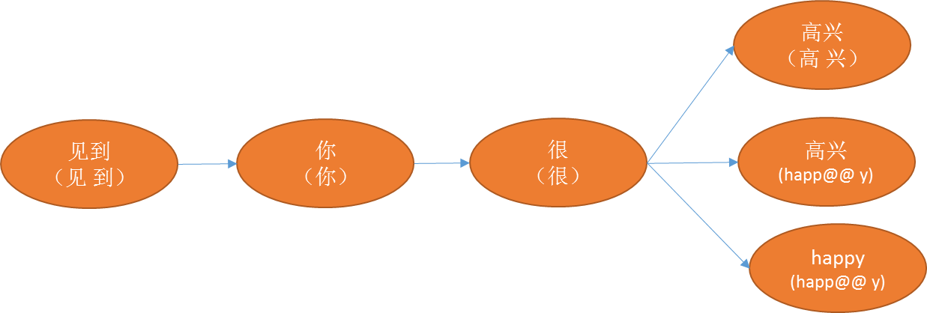
Language-Universal Mandarin-English ASR
Idea3、 Word Space Mapping
Case： 见到 你 很 happy
LM score： P(happy| 你 很) —>P(happy)
Word Mapping：f(happy) -> 高兴， P(happy| 你 很) —> P(高兴|你 很)
Lexicon：
词条 | 发音
高兴 | 高 兴
高兴 | happ@@ y
happy | happ@@ y

Slide 16
Language-Universal Mandarin-English ASR
Idea3、 Word Space Mapping
Method | Test1 | Test2
Base | 17.12(33.40) | 18.54(25.15)
WSP | 16.98[32.73] | 17.56[23.63]
Label | 处 理 data 的 部分
Base | true data 部 分
LM-Mapping | 处 理 data【数据】 部 分
Label | 那 这 个 machine learning 我 会 主 要 觉 得 它 是 一 个 三 块 三 块 这 个 knowledge 的 结 合 哦
Base | 那 这 个 machine learning 我 会 主 要 觉 得 他 是 一 个 三 块 三 块 这 个 knowledge that 结 合
LM-Mapping | 那 这 个 machine learning 我 会 主 要 觉 得 他 是 一 个 三 块 三 块 这 个 knowledge 【知识】 的 结 合

Slide 17

Language-Universal Mandarin-English ASR
Demo

Slide 18


thanks

